Slide 1
Smart India Hackathon 2017
Ministry Category : Indian Space Research Organisation (ISRO)
Problem Statement : Storing emails on mailbox server in encrypted format accessible only to owner of the email
Team Leader Name : Anup Kumar Panwar
Problem Code : #ISR1
Current AICTE Application No. : 1-3328528908
IDEA
Our idea is to develop a SECURED & ENCRYPTED EMAIL SERVICE (both App & Website). Normally Email services provide STORAGE LEVEL ENCRYPTION which are decrypted on-the-fly and that too with a SINGLE KEY. So, we have tackled the drawbacks in this ON-THE-FLY DECRYPTION and SINGLE KEY approach:-
Our approach is based on Asymmetric Encryption; We will be utilizing biometrics (namely finger prints) of the sender and the receiver to encrypt the emails content.
The finger print will be used to generate a PRIVATE TOKEN and a PUBLIC HASH.
A RANDOM SALT will be generated under MD5 ENCRYPTION ALGORITHM and SERVER TIMESTAMP;
The PUBLIC KEY(I.E., FINGER PRINT HASH) + SALT will be used to generate an INITIALIZATION VECTOR (IV) that will again undergo MD5 ENCRYPTION;
Then this INITIALIZATION VECTOR will be used to encrypt the email content using AES 128 BIT ENCRYPTION TECHNIQUE;
This Encrypted content will be BASE64 ENCODED and stored in the database. (NOTE : The private key is NEVER STORED anywhere in any form. It will be provided by the receiver at the real time for content decryption.)
The recipient of the email will see the content of the email in encrypted form which no one can understand. To read the actual content he has to provide his FINGER PRINTS. This decryption is temporary and at the VIEW LEVEL ONLY . Once the user has read the actual content, as soon as he redirects from the web page. The temporary decryption will vanish and the email will remain in encrypted format. (NOTE : the email is never decrypted at STORAGE LEVEL.)
Moreover the sender of the email will get a notification if number of wrong password attempts exceeds a preset value(say 3).Then he gets an option to delete the email permanently from the server (Even from the receiver’s inbox for the sake of security).
Not only biometrics but the user also gets an option to encrypt the email with a string or use a file as a key using SYMMETRIC ENCRYPTION in a similar way with an added benefit of using different keys for each email. Biometric encryption is our primary focus due to it higher security and convenience.
Technology Stack
Angular.js, jQuery, PHP, MySQL DB, Mcrypt, AJAX, OpenSSL, Asymmetric Encryption, MD5 Encryption Algorithm, AES 128 bit Encryption Algorithm, PHP Mailer, APACHE server, WAMP/LAMP, Ionic Framework, ng-Cordova, Android Studio + SDK version 23, Node.js, HTML, CSS, Material Design Light (MDL), JavaScript

Slide 2
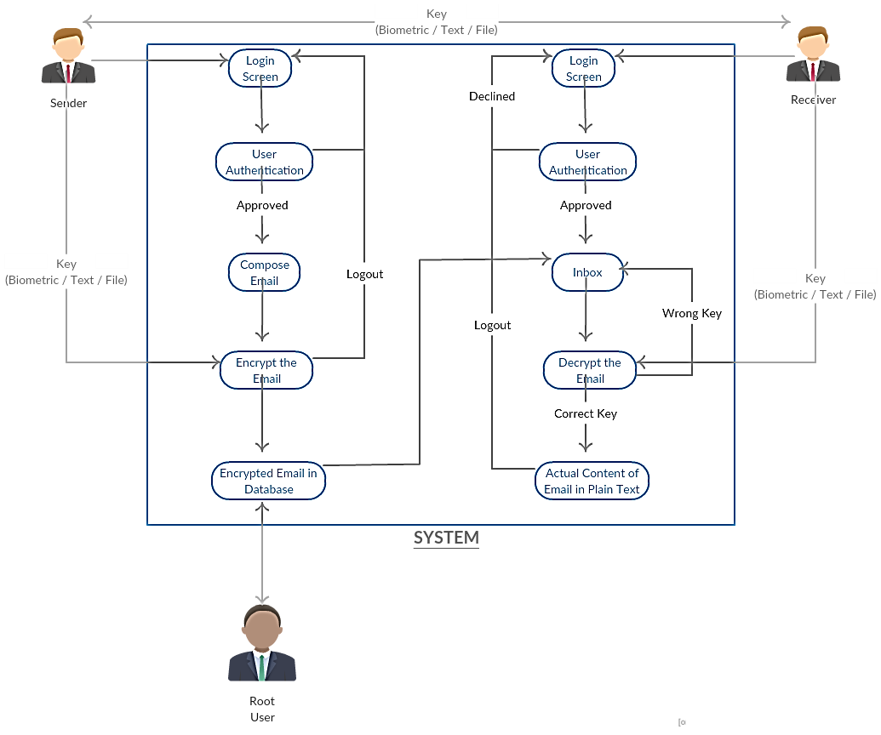
Public Key
Private Key
USE CASE
DEPENDENCIES
Android Device with Finger Print Scanner and Minimum SDK version 23, Internet Connection, A computer with Biometric Scanner

Slide 3
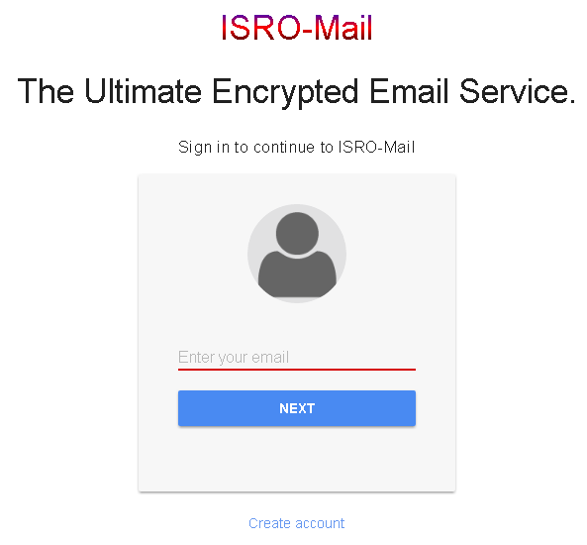
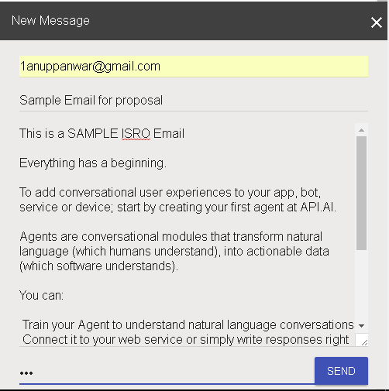
Some Work in Progress
LOGIN
COMPOSE EMAIL
STRING | FILE | FINGER PRINT

Slide 4
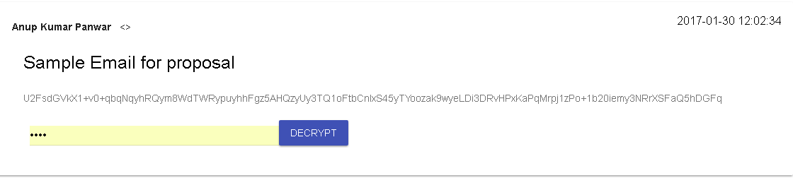
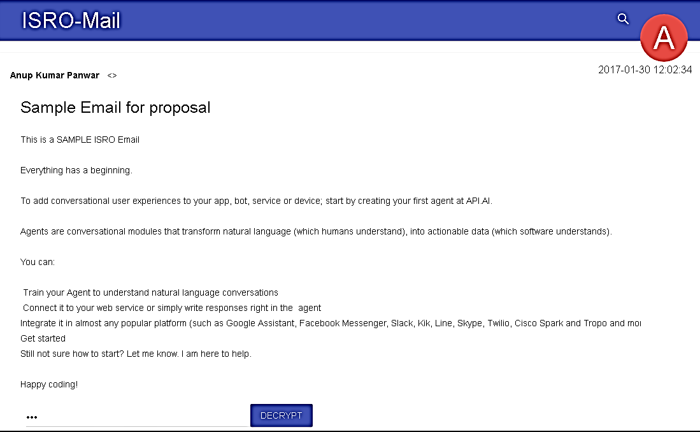
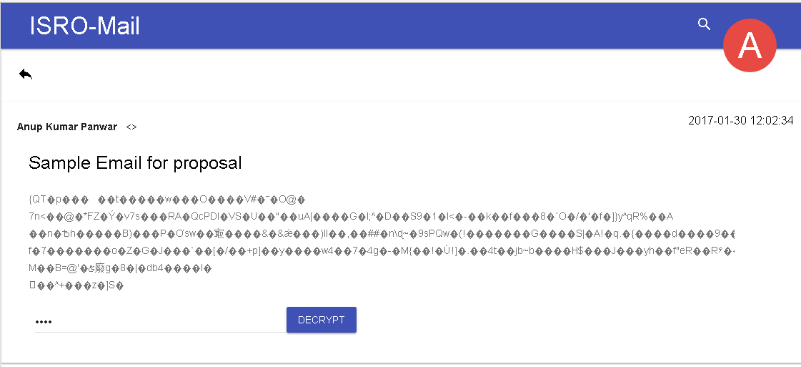
INBOX
CORRECT KEY
WRONG KEY

Slide 5
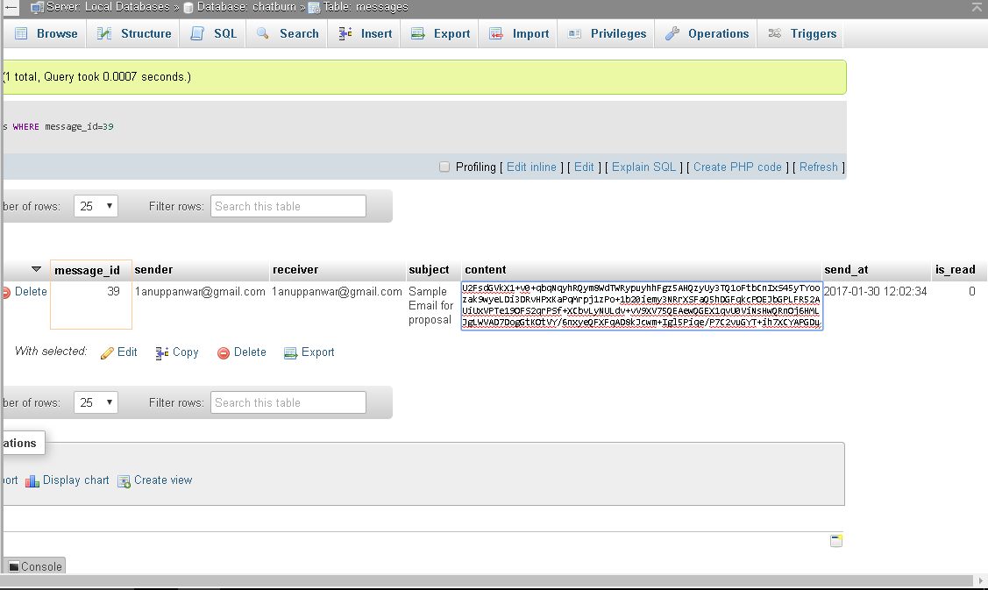
HOW IS APPEARS TO THE ROOT USER
More coming soon…

